Slide 1

Bangalore Restaurant Selection
by Rahul M 2019

Slide 2
Business Problem
The client “JanakiRam (JR)” is a leading chain of restaurants based in North India. It has outlets mainly in Delhi and Mumbai where it has a loyal customer base. JR has enjoyed a fair amount of success which it wishes to replicate in the South. JR has chosen as Bangalore as its pilot location to launch its outlets in South India.
JR has approached us to determine an ideal location to start its foray. JR wants to ensure that the location chosen is economically feasible for setup as well as a key hub where it can start getting customers from the very beginning.
Business Problem: “Determine a location/set of locations for a restaurant in Bangalore to open a new restaurant”
The project is of utmost importance to the client JR and other restaurant players looking to expand their businesses in Bangalore. It can also be used for new business entrants to understand which localities have what types of entry opportunities to venture into
by Rahul M 2019

Slide 3
Data
Data Source 1:
The city of Bangalore is divided into multiple areas or boroughs within which there are a set of neighbourhoods. Data on the boroughs and neighbourhoods was obtained from scraping Wikipedia.
Link : -
https://en.wikipedia.org/wiki/List_of_neighbourhoods_in_Bangalore
Data Source 2:
Geocoding: The latitude/longitude of the neighbourhoods was not easily available from the geocoder API. After multiple iterations, it was decided to populate this information manually by googling each neighbourhoods separately and finding its coordinates.
Demographics: The demographics of each locality were also determined through google search and reasonable approximations
Commercial Property Rates: Primary research with rental brokers for a few neighbourhoods was conducted to determine the average price per sqft. This was adjusted for error and approximated for other neighbourhoods
Data Source 3:
Data from Data Sources 1&2 were combined into an excel workbook ‘Bangalore Geocoding Information.xls’ with all the information determined to be used for the actual data analysis. The excel workbook was uploaded on Dropbox. The workbook can be downloaded from the below link-
https://dl.dropboxusercontent.com/s/fan21pjc5qwjov5/Bangalore%20Geocoding%20Information.xlsx?dl=0
by Rahul M 2019

Slide 4
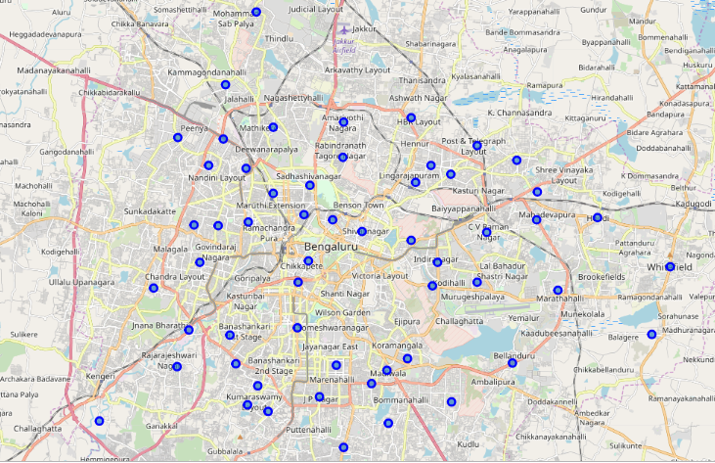
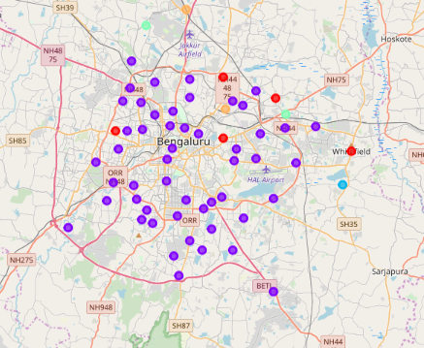
Methodology and Results
K-Means clustering was used to segment the neighbourhoods on the basis of frequency of venues derived from Foursquare
Neighbourhoods under “Restaurant” cluster were analyzed on the basis of commercial land rates to come up with a list of neighbourhoods – JP Nagar, Cantonment, Basavangudi, Bommanahalli, Banashankari
by Rahul M 2019

Slide 5
That is it! Thank You for your attention!
by Rahul M 2019

